Slide 1

BACK-END DEVELOPMENT INTERNSHIP REPORT
PRESENTED BY SHUBHAM GUPTA
20296202717

Slide 2

ABOUT THE COMPANY
We are Crazy is a non-profit educational organization that teaches personal development through a worldwide network of clubs.
We are Crazy is helping people from diverse backgrounds become more successful, happy and rich.
The founders of this company is Mr. Himanshu Singh.
Their vision is to deliver accessible, quality and affordable comprehensive products, through a chain of We are Crazy.
To implement the vision, We are Crazy is building a smart, scalable, next generation, affordable and trusted platform for an integrated preventive comprehensive urban world.

Slide 3

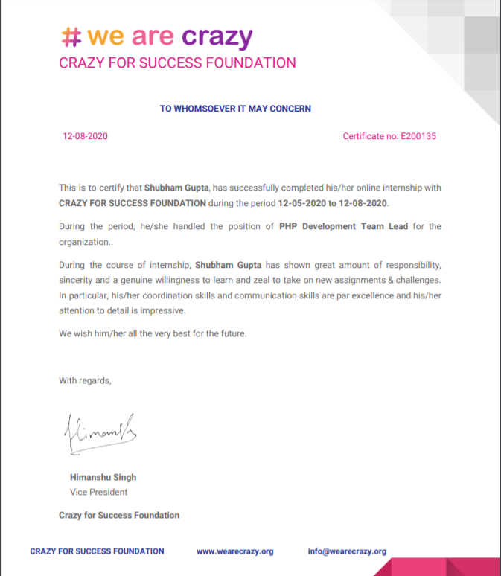
Certificate

Slide 4
DOMAINS OF PROJECT
LANGUAGE AND LIBRARY
The areas in which the project falls is Server Side Programming in this we try to access a web application using the HTTP request to access the frontend and backend.
PHP, JSON, SQL, REST API, HTML, CSS, JS, BOOTSTRAP
PRE REQUIRED KNOWLEDGE
TOOLS USED
PHP, MySQL, HTML, JSON
VS CODE IDE, PHP Server, MySQL, POSTMAN, WEB BROWSER

Slide 5
BREAKING PROJECT IN PHASES OF SOFWARE DEVELOPMENT LIFE CYCLE
PHASE - I
PHASE - II
PHASE - III
Documentation about the concepts or algorithms used in this particular project. This shall be a breif introduction for you before you start the projects. It correspond to Requirement Phase of SDLC
This phase includes the working diagrams, like context diagram, class diagrams, use case and data flow diagram. This is a overview on working of the project and corresponds to Design and Analysis Phase of the SDLC.
Implementation Phase of the Project, here we'll have the working codes, and explaination of the core functions and scripts of the codes with maximum comments.
Other then that we'll add some scope for improvement

Slide 6
KEY POINTERS OF PROJECT
The key features of the project are:
Register and login functionality
Add and view Products in the system.
Add and update the products uploaded.
View Orders.
View All Sellers.
View All Customers.
Input of the project: Product uploaded on website.
Output of the project: Orders placed by the customers.

Slide 7
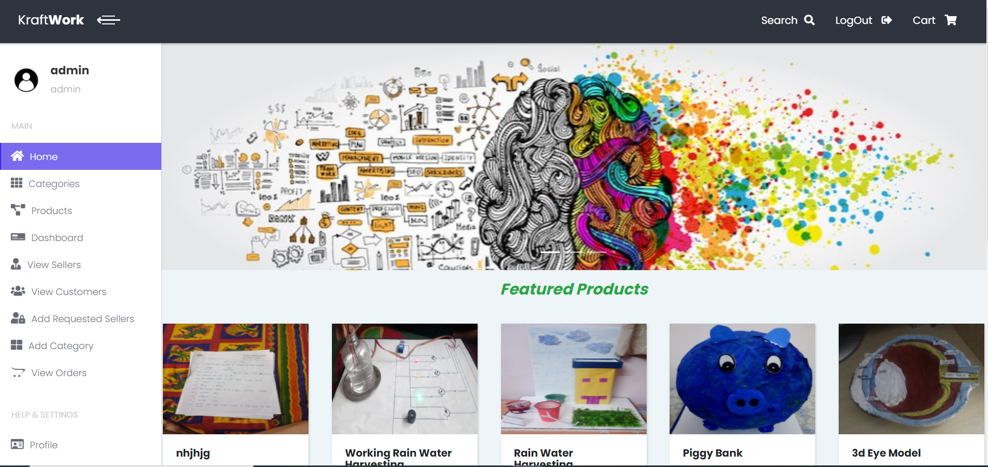
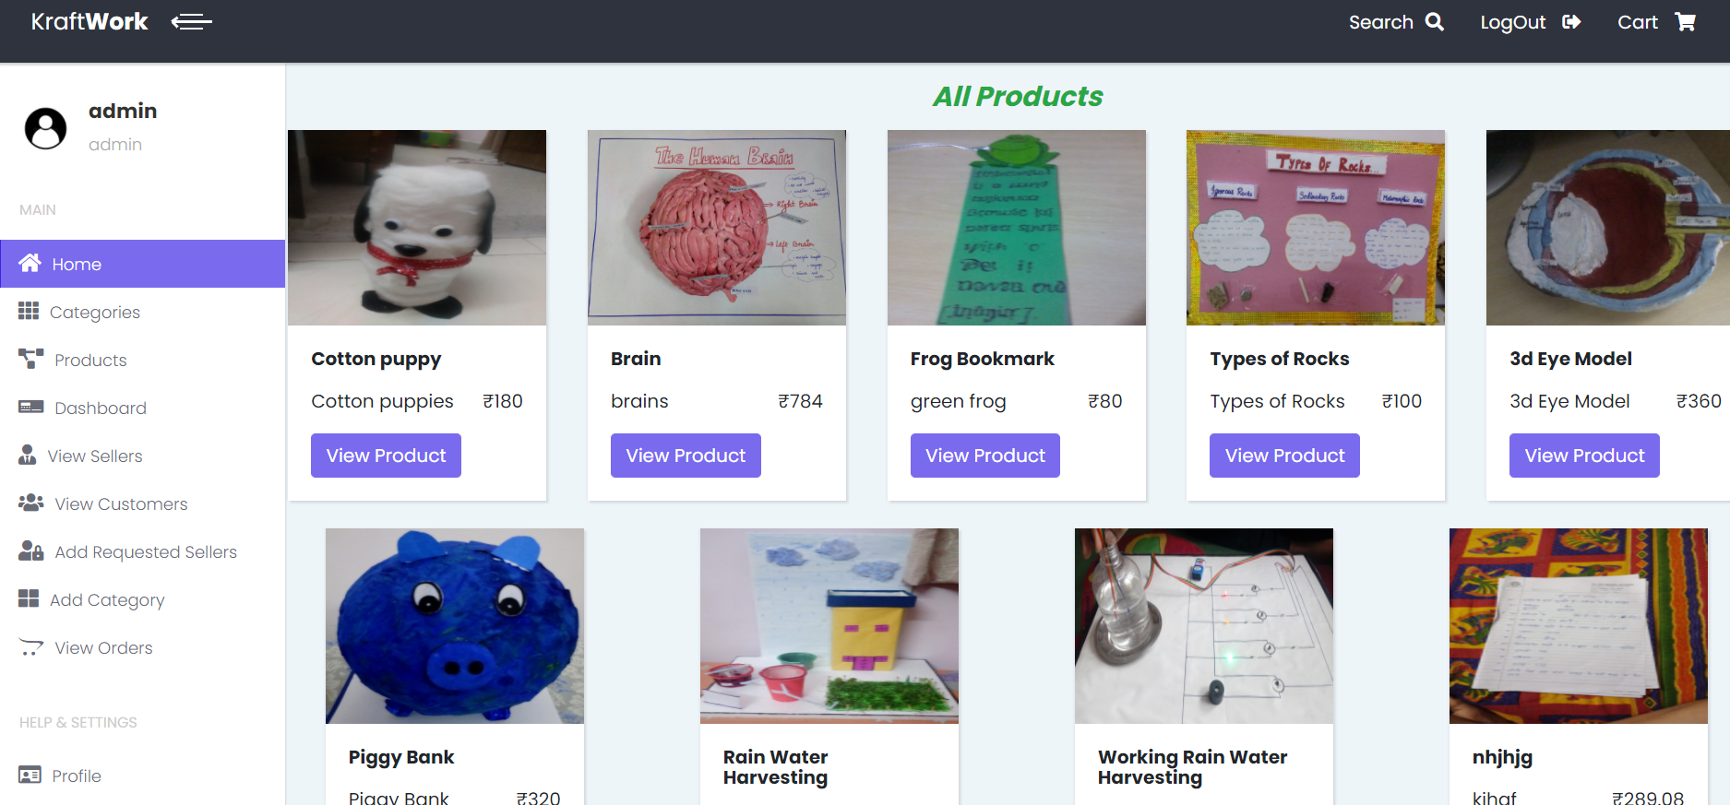
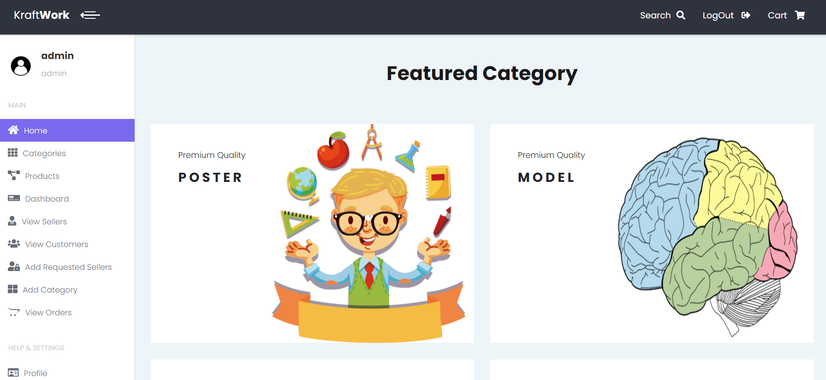
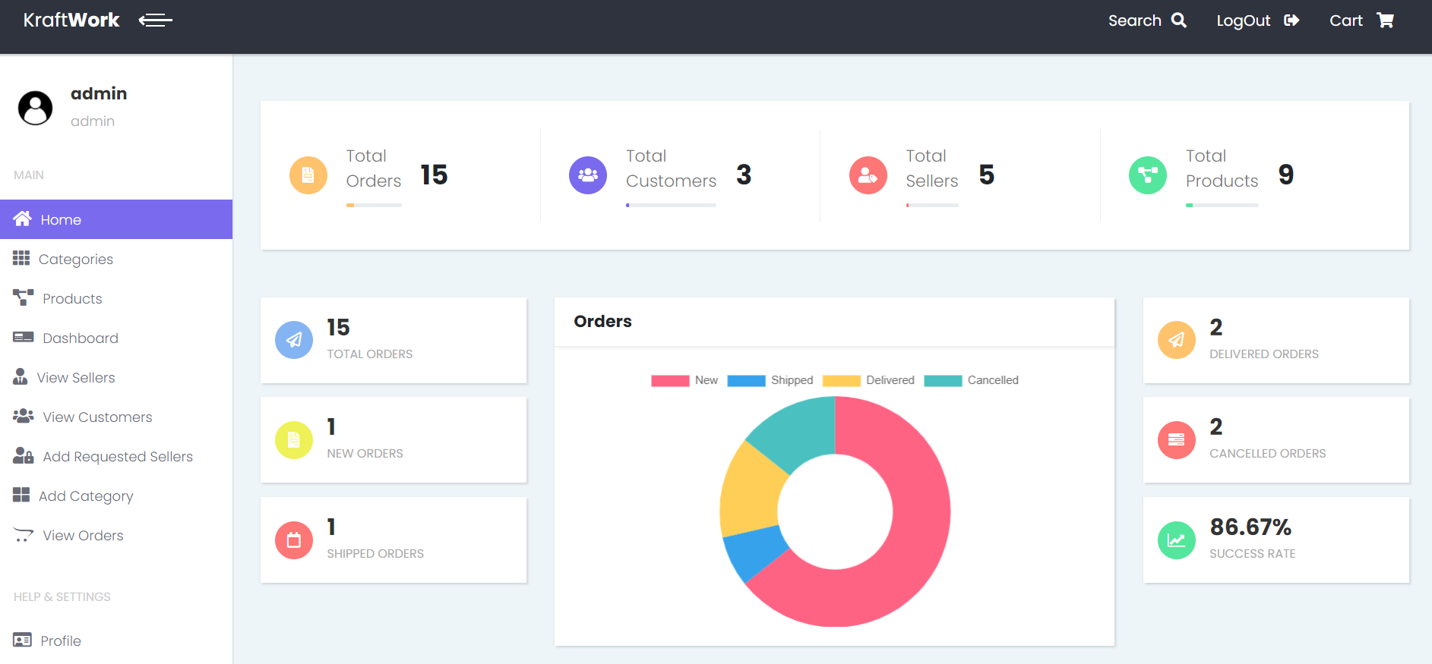
Screenshots
Home Screen
Products Page
Category Page
Dashboard

Slide 8
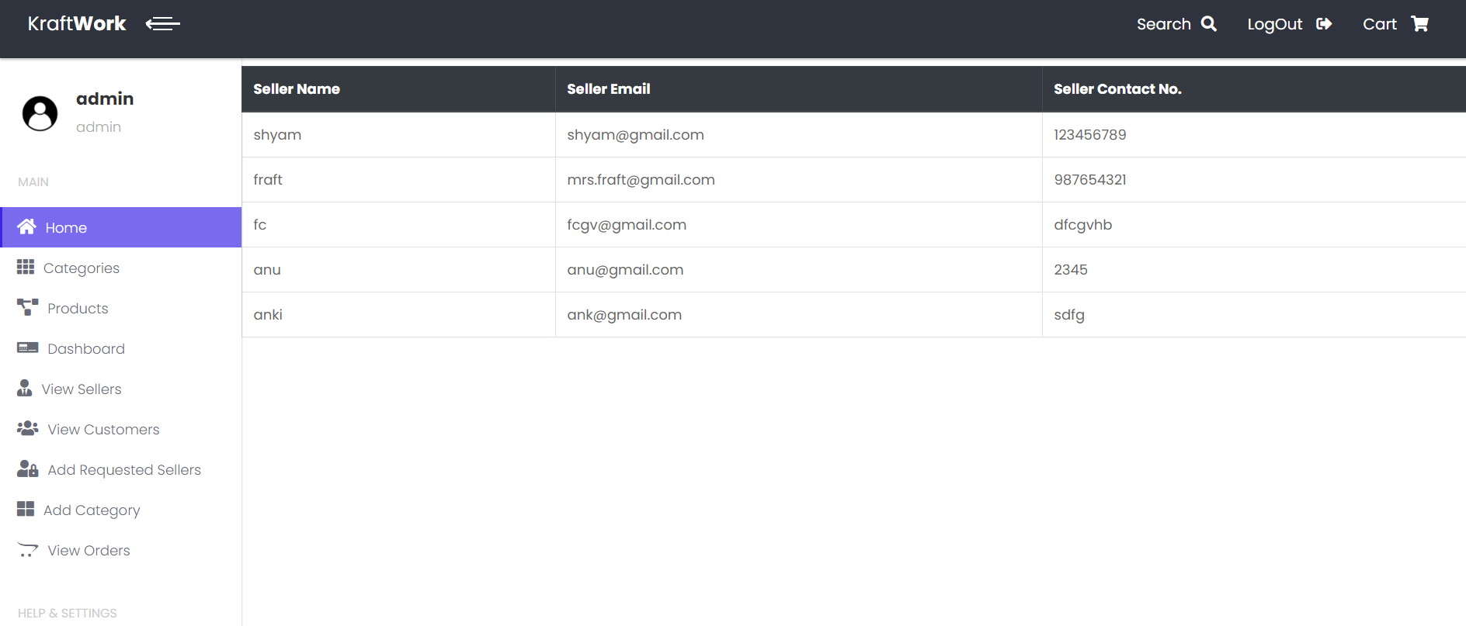
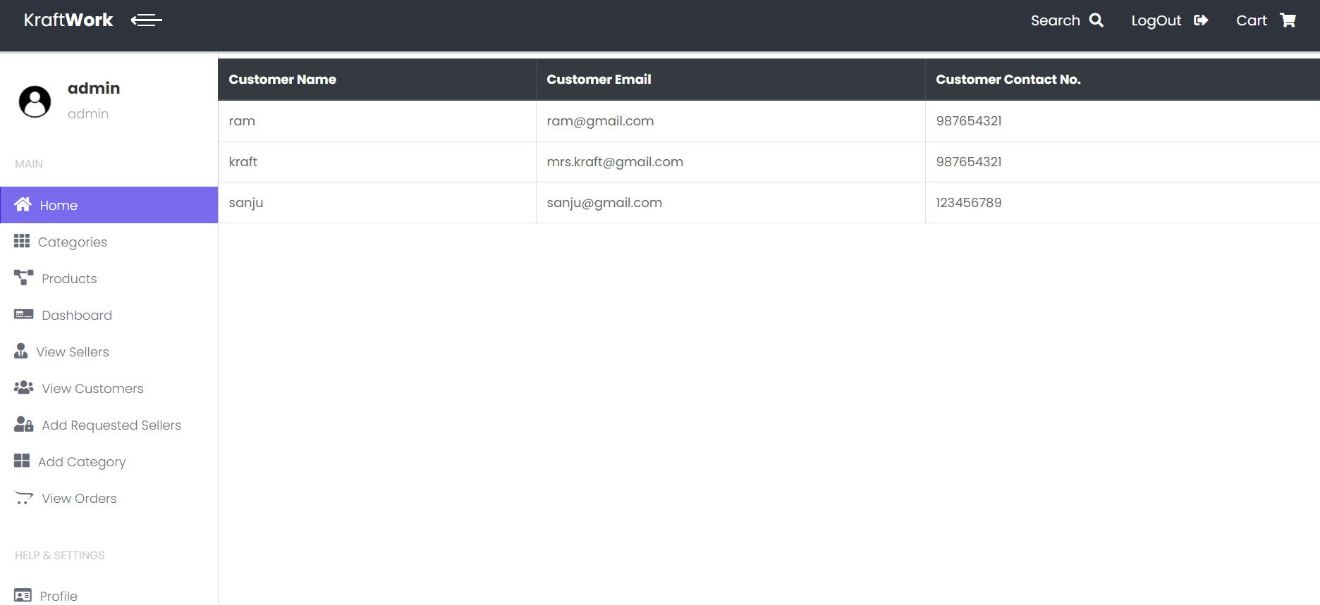
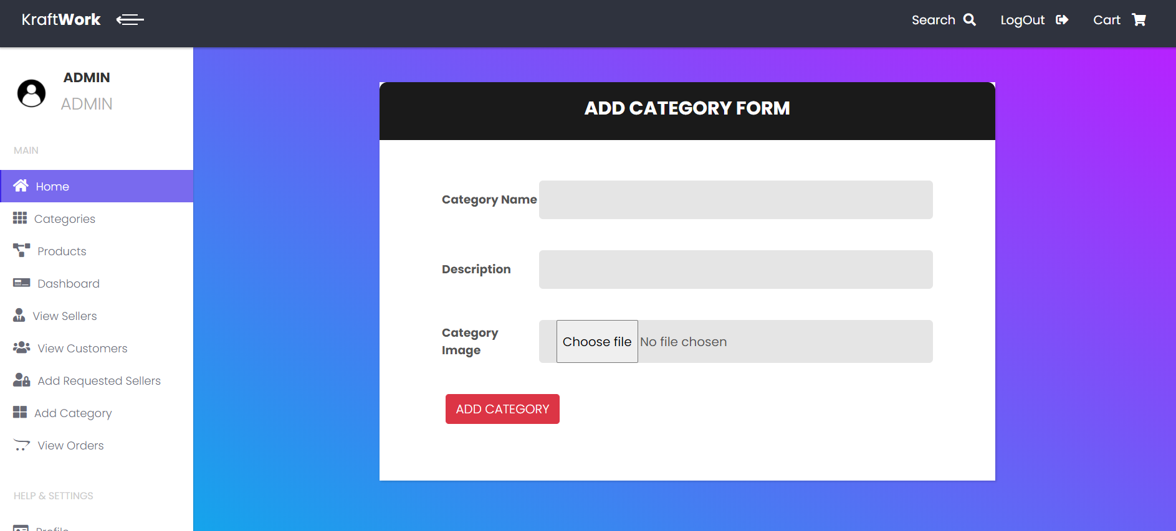
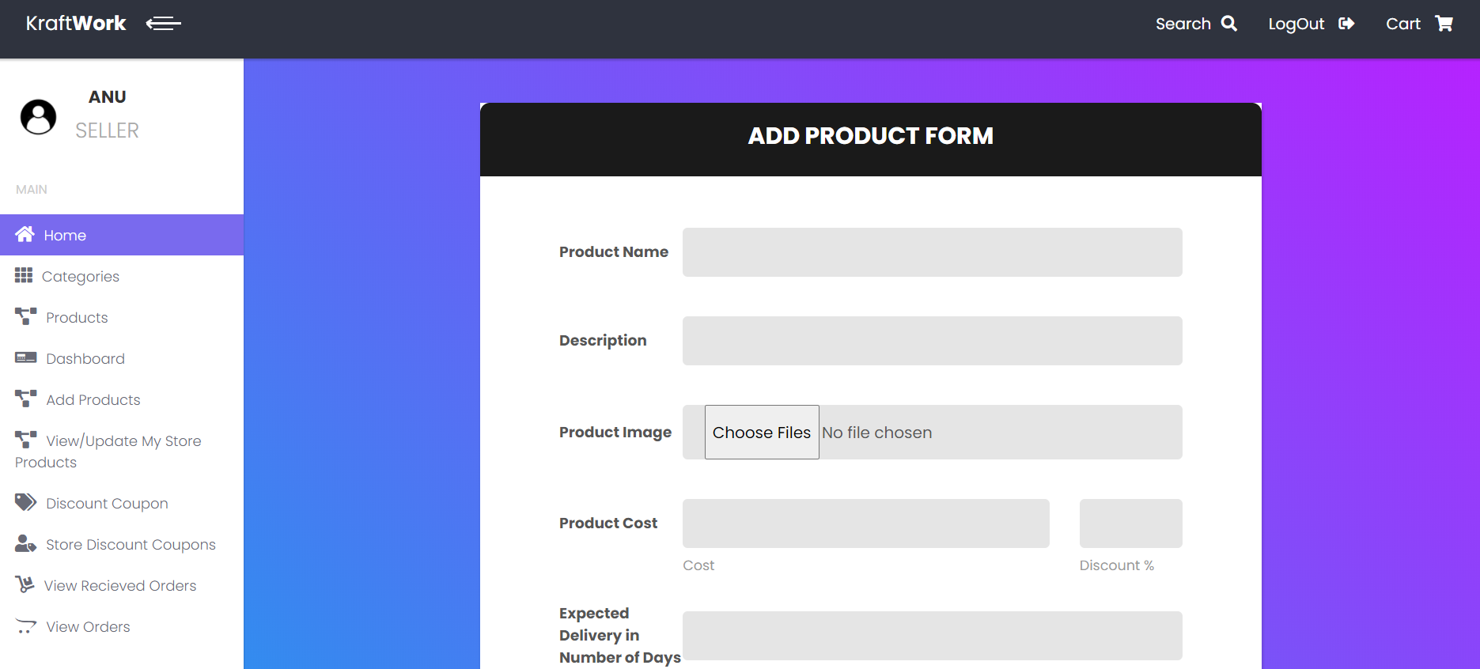
View Sellers Page
View Customers Page
Add Category Page
Add Product Page

Slide 9
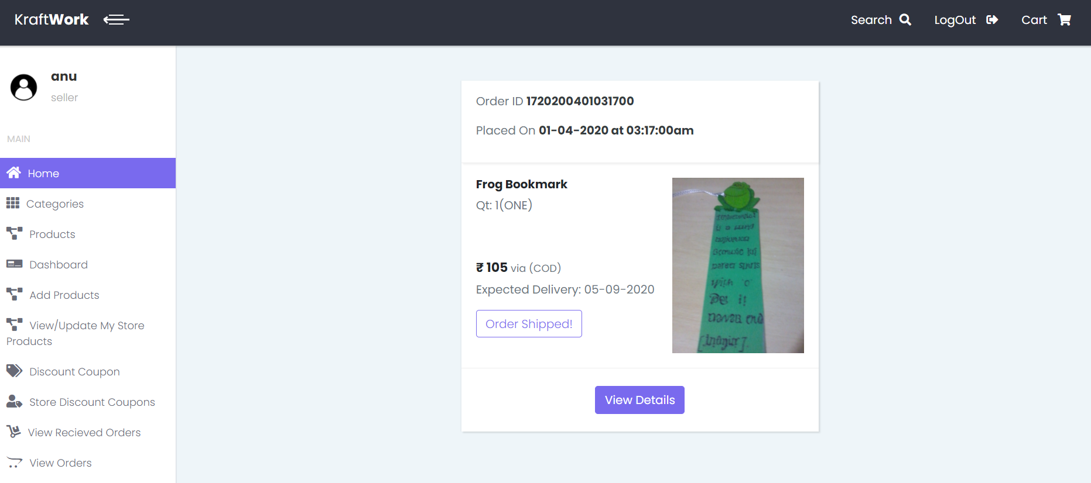
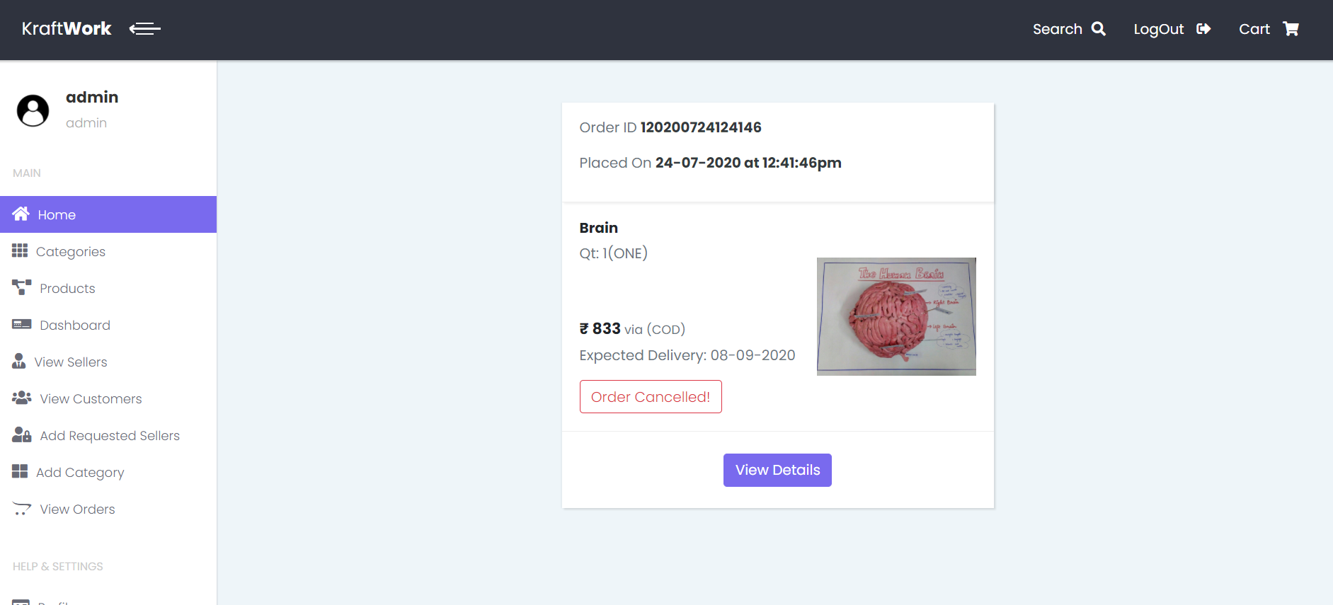
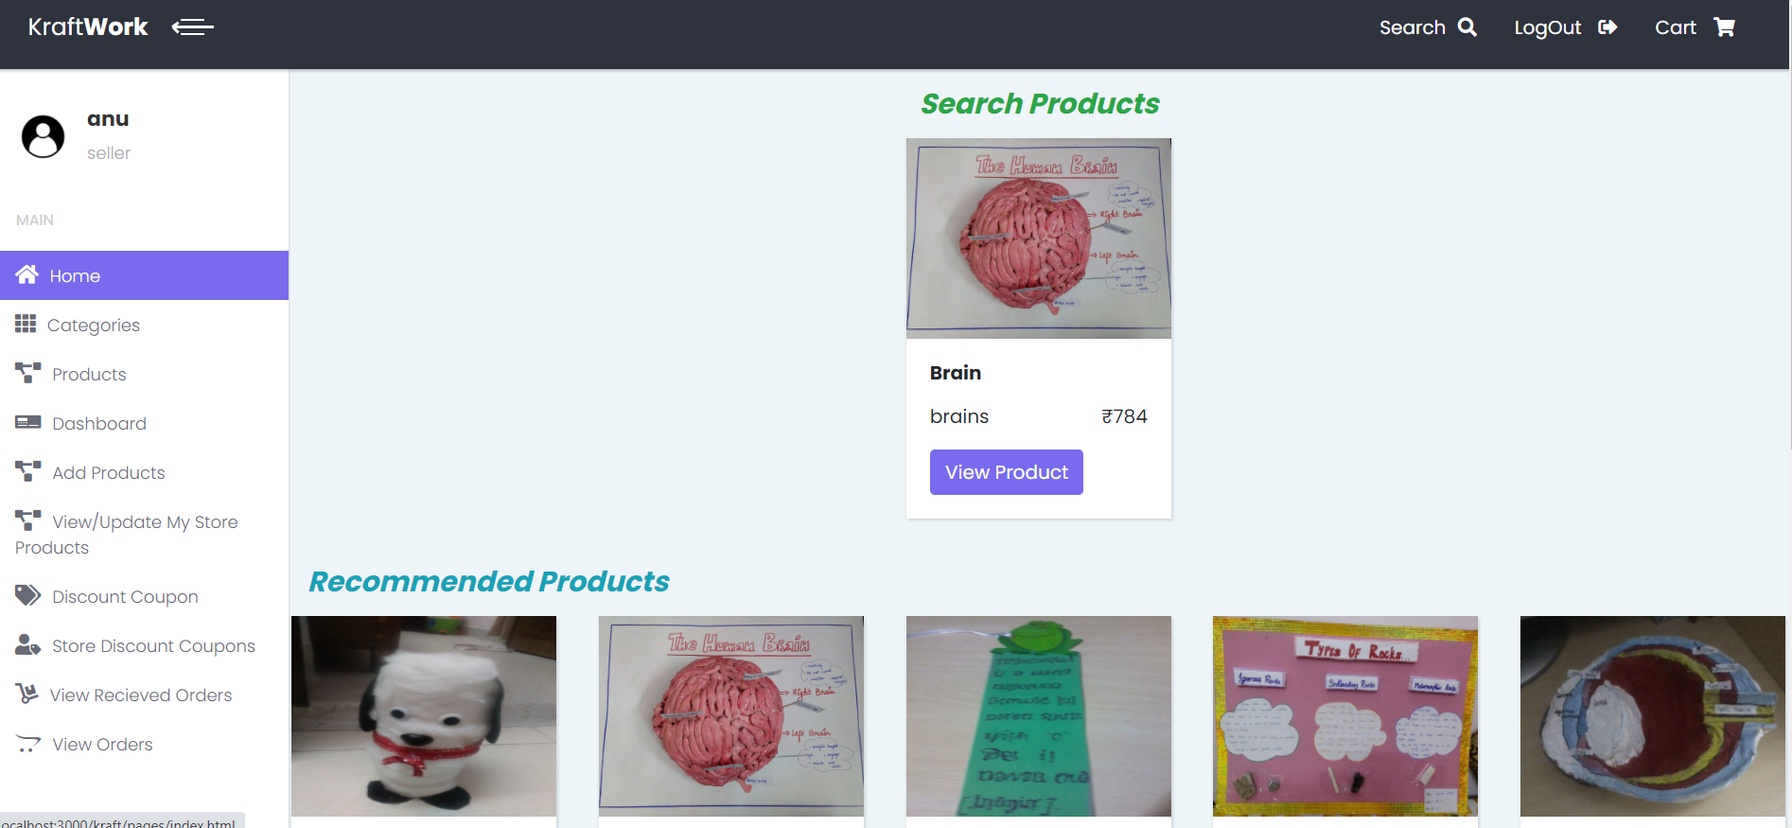
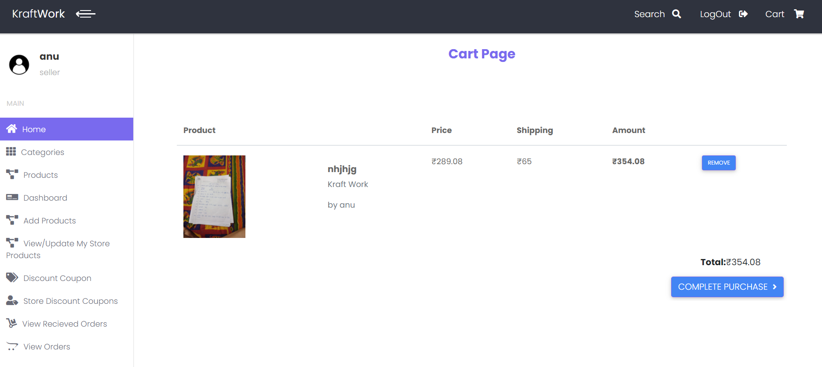
View Received Orders Page
View Orders Page
Search Page
Cart Page

Slide 10
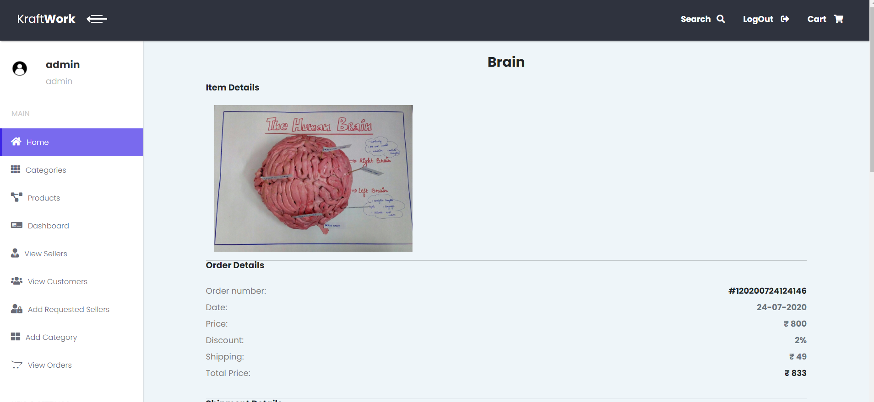
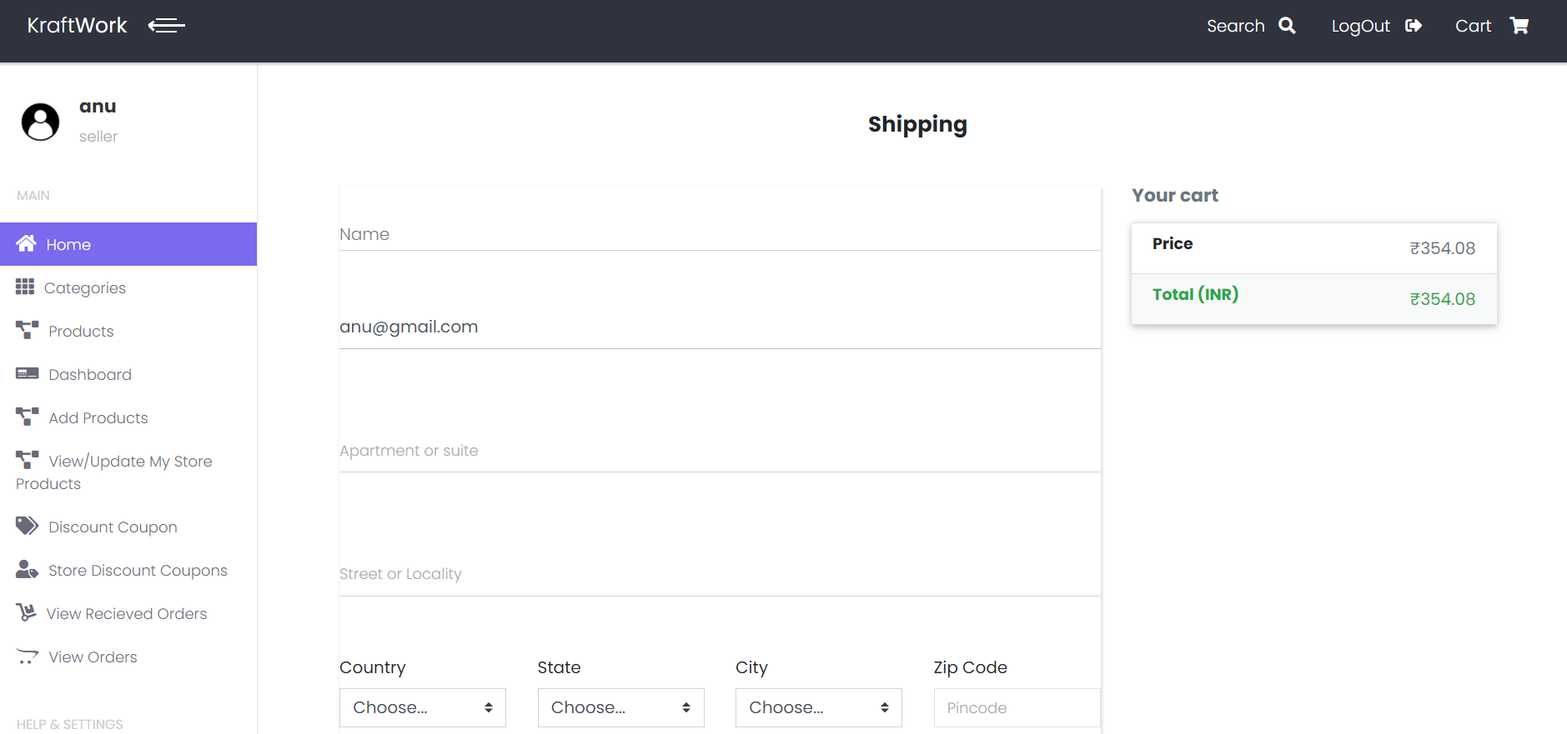
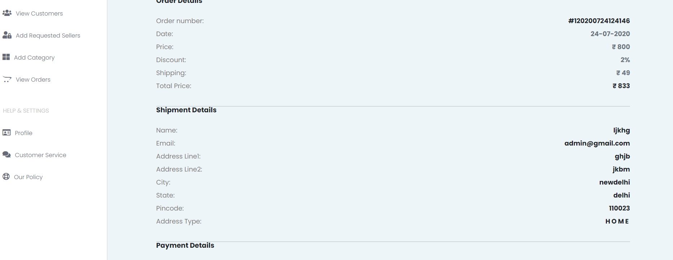
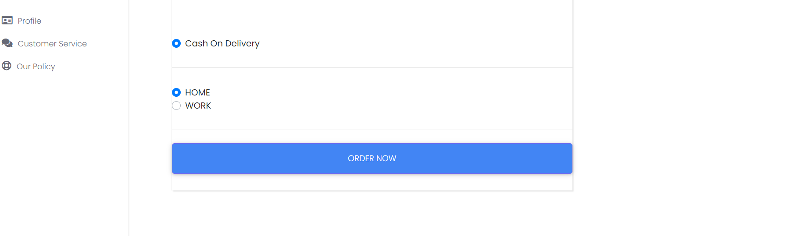
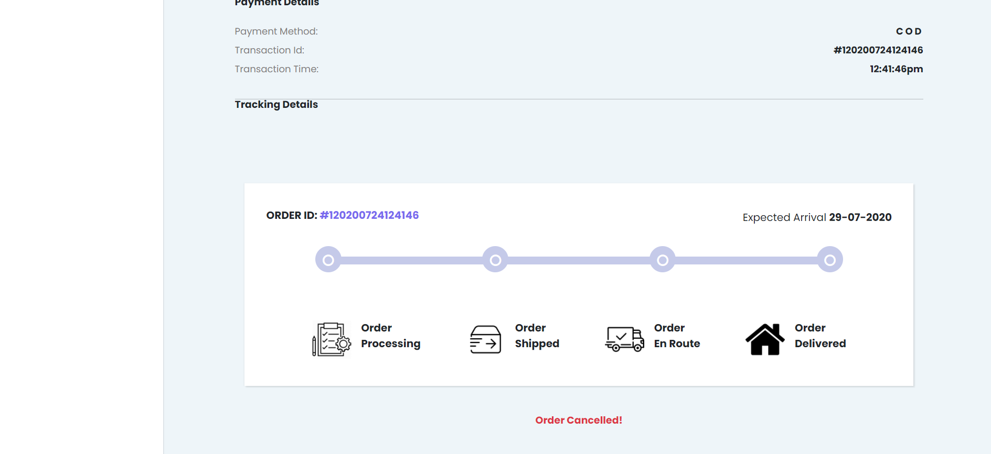
View Orders Details Page
Shipping Page

Slide 11

Future Scope
The Sellers And Admin can Add products in the application
The changes in the applications like Category, Products can be added.
The Seller gets to know whenever the customer places an order.
Various orders and the Order Status can also be set dynamically

